Slide 1
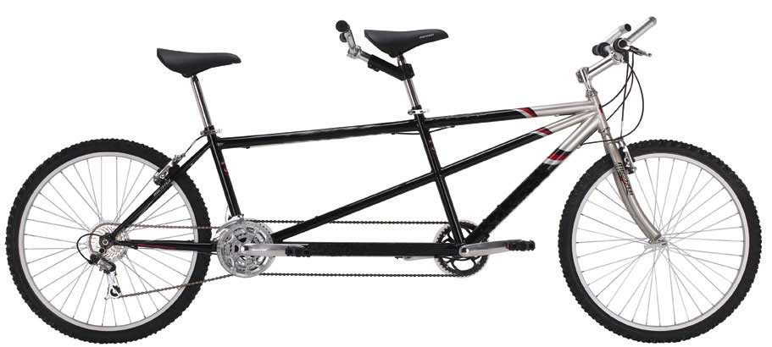
TANDeM
The Australian Mammographic Density Network
This National Collaborative Breast Cancer Research Grant Program proposal developed from the committed and enthusiastic engagement of researchers and clinicians from around the country that is internationally linked and competitive.

Slide 2
Background
Mammographic Density (MD) for age is a strong and heritable risk factor for breast cancer
Higher MD leads to poorer screening test sensitivity and specificity
Evidence not integrated into clinical practice
Aetiological processes behind these associations are not yet understood
National meetings:
Why study Mammographic Density (August 2010)
NBCF supported Think Tank (August 2011)
Engagement to write collaborative program of work focusing on four key areas:
MEASUREMENT
BIOLOGY
GENETIC/EPIGENETIC
TRANSLATION

Slide 3
Measurement
E.1 Improve performance screening

Slide 4
Measurement
E.2 Predicting breast cancer risk

Slide 5
E3. Biology of Mammographic Density

Slide 6
E4. Genetic and Epigenetic Factors
Studies of MD determinants
Studies of BC risk
GWAS
Candidate gene studies
GWAS
of methylation
iCOGS
BCAC
GWAS of extremes
Linkage
50-80 common genetic variants (SNPS) associated with breast cancer risk
Expand methylation study size
Include analysis of breast cancers
Validate epigenetic variation associated with MD
Validate epigenetic variation associated with MD
Test/validate SNPs for association with MD
Test/validate SNPs for association with MD
Characterization of genomic regions
Targeted MPS and BS-MPS
Apply various study designs
Characterization of genomic regions
Targeted MPS and BS-MPS
Apply various study designs

Slide 7

Informatics
Designed to facilitate collaboration
Securely accessible from anywhere there is an Internet connection
Single instance supports multiple users
Data is stored centrally and the application and data is managed professionally
Multiple levels of security
Platform for integrated data management and data query/extraction
Participant/patient data
Phenotypic/clinical data
Pedigree data
Biospecimen samples
Genotypic data
Highly configurable and extensible
User-defined custom fields and data sets
Designed to be entirely configured by system users with no programming required
Open-source software
Collaboratively developed by UWA, University of Melbourne and the OBiBA project (Montreal, Canada)

Slide 8
Informatics

Slide 9
Structure

Slide 10
E5. Translation
5.1 Risk Modeling
New information from this program
- environmental
- genetic
- lifestyle
Current information/models
BOADICEA and others
current projects (NHMRC/NIH)
Risk Modeling
Consider all factors concurrently
Feasibility ?
Process ?
Impact ?
Public screening programs
Identify and target women at highest risk
Prevention, earlier diagnosis, better outcomes

Slide 11
E5. Translation
In Collaboration with BreastScreen Australia:-
Qualitative research
How should women be informed about their MD?
Feasibility to routinely automatically measure MD?
Pilot integration into hardware, software and workflow (digital)*
Adjunct ultrasound screen to increase sensitivity in women with dense breasts.
Change in health outcomes and resource requirements
* errata

Slide 12
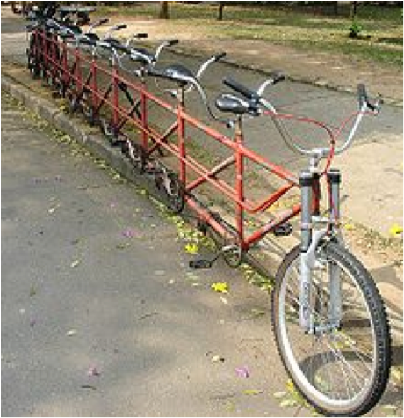
TANDeM
The Australian Mammographic Density Network

Slide 14
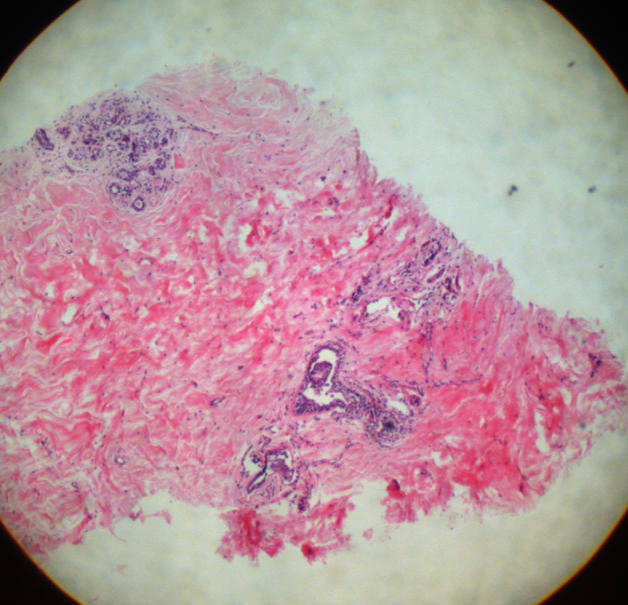
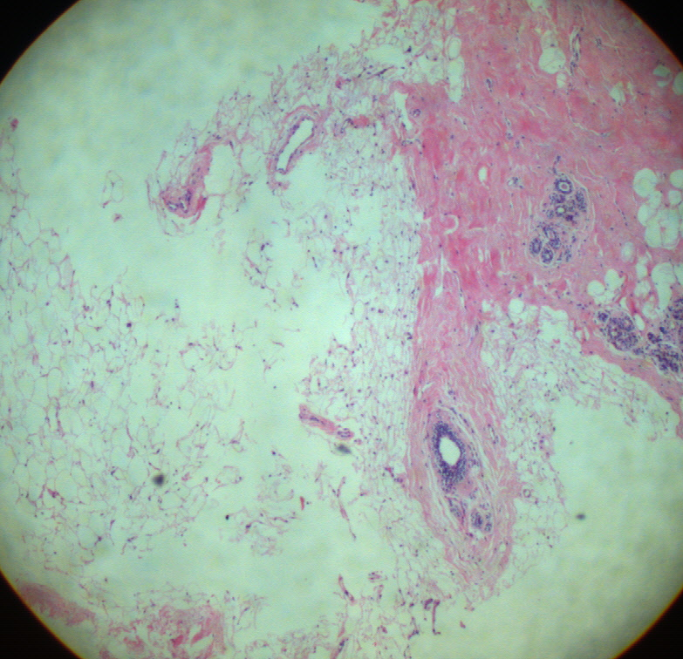
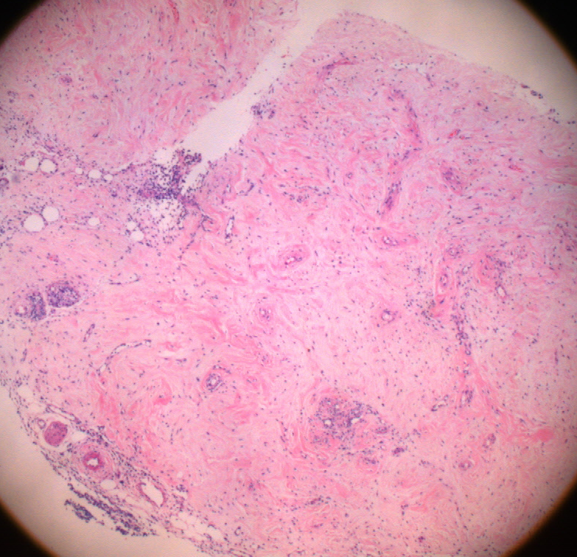
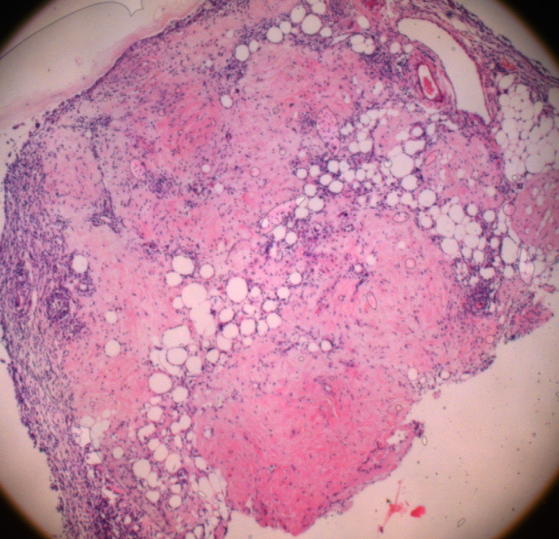
Fig. 1
High MD mastectomy tissue
Low MD mastectomy tissue
a
b
c
d
200μm
High MD chamber tissue
Low MD chamber tissue

Slide 15
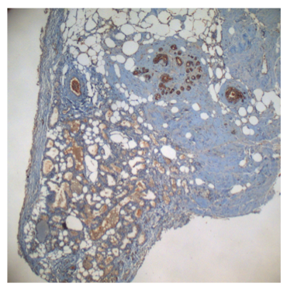
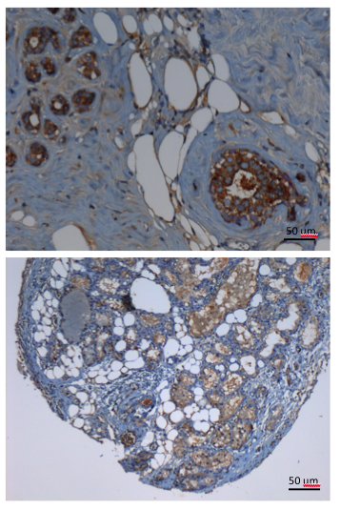
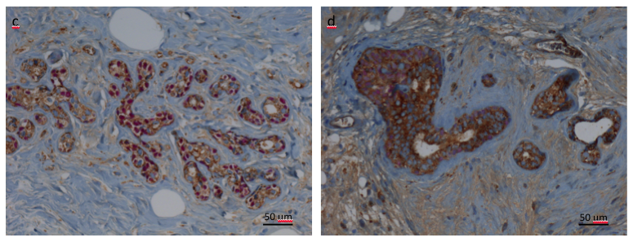
a
b

Slide 16
Fig. 7
p=0.0004

Slide 17
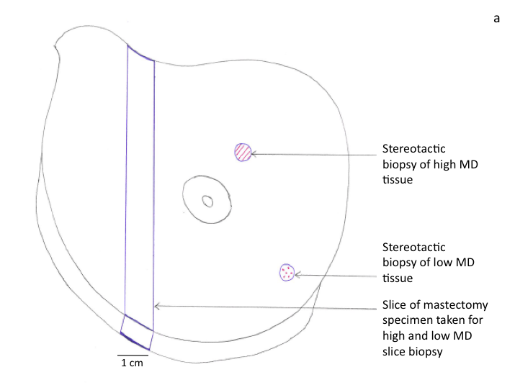
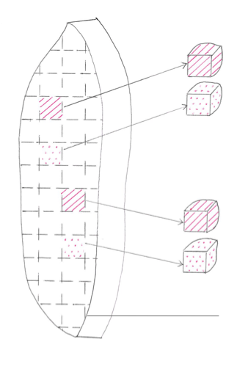
a
b
1
2
1
3
4
2
3
5
Notes:
Figure 3a: 1 – stereotactic biopsy of high MD tissue, 2 – stereotactic biopsy of low MD tissue, 3 – slice of mastectomy speciment taken for high and low MD slice biopsy. 3b: 1 – slice biopsy of high MD tissue for FACS, 2 – slice biopsy of low MD tissue for FACS, 3 - slice biopsy of high MD tissue for ECM reconstitution, 4 - slice biopsy of low MD tissue for ECM reconstitution, 5 – radiographic grid to assist with identification of high and low MD regions under x-ray imaging

